Slide 1
Nature Inspired Based Selection For Prediction Of Customers Churn Rate-A Machine Learning Approach
Project III (PROJCS801)
In partial fulfilment of the Degree of
Bachelor of Technology
In
Department of CSE(IOTCSBT)
Submitted by:
Rajesh Burnwal (22021002017003)
Mehwish Tanweer (22021002017011)
Under the Guidance of
Prof. Rabi Narayan Behera
Institute of Engineering and Management, Kolkata 2024

Slide 2
Content of the Presentation
Topic | Slide No:
Introduction | 3
Proposed Work | 4
Data Flow | 6
Result and Analysis | 7
Comparison With Existing Work | 10
Conclusion and future works | 11
References | 12

Slide 3
Introduction
Problem Statement:
Despite improvements in machine learning, telecom churn prediction lacks effective feature selection methods.
Current approaches fails in identifying most relevant features from vast datasets.
Resulting in poor predictions and limited actionable insights for organizations.
Fixing this gap is crucial for making better churn predictions.
Better models with special ways to pick features help make smarter decisions and keep customers around.

Slide 4
Proposed Work
The aims of this project are in two fold
Firstly,
Propose and implement a nature-inspired feature selection method for telecom churn prediction.
Evaluate the effectiveness of three distinct nature-inspired algorithms - Cuckoo Search Algorithm (CS), Firefly Algorithm (FA), and Grey Wolf Optimizer (GWO).
Secondly,
Selection of classification model Support Vector Machine(SVM) as the base classifier for churn prediction.
Apply optimization algorithms (CS, FA, GWO) to enhance SVM parameters.
Improve predictive accuracy and robustness of SVM.
Through rigorous experimentation and analysis, contribute valuable insights.

Slide 5
Requirements
Software Specification: | Operating System : Windows, Mac Backend: Python Integrated Development Environment (IDE): Jupyter Notebook or PyCharm
Hardware Specification: | Processor: Intel i3 or above RAM: 4GB Hard Disk:16 GB Internet Connection

Slide 6
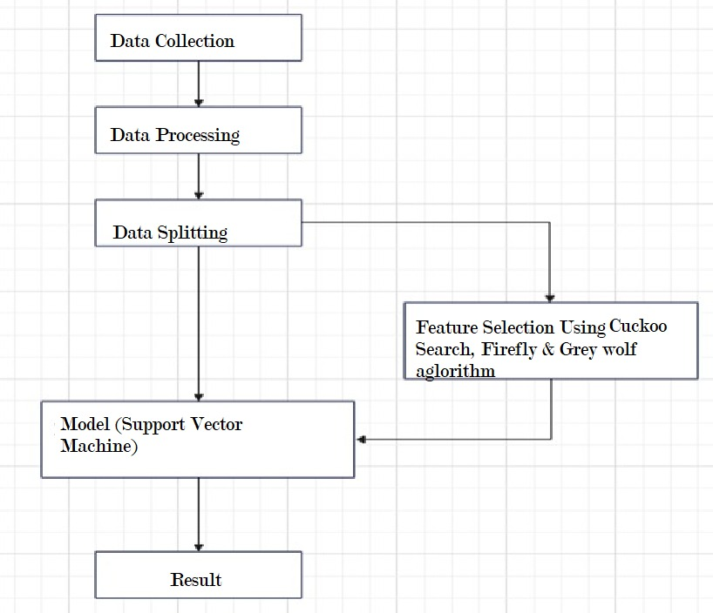
Data Flow

Slide 7
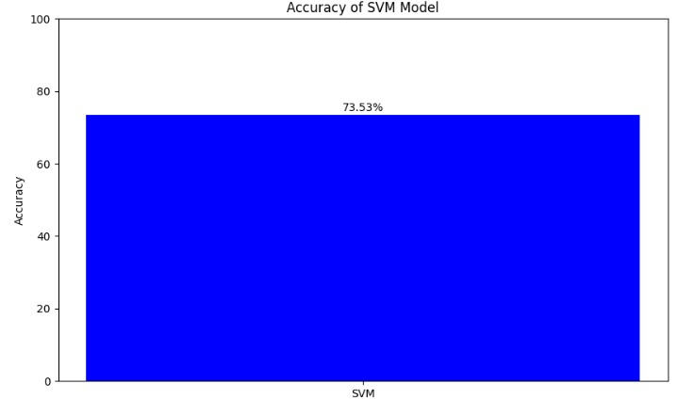
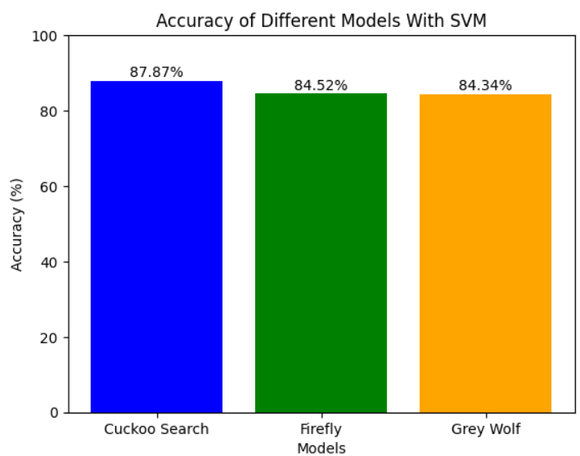
Result and Analysis
Feature optimization is yielding promising results in several key areas, accuracy, reliability, and feasibility.
Accuracy Of SVM before feature Extraction.
Before applying feature selection, the models were trained on all the features of the dataset. But After applying feature selection using nature based feature extraction algorithm, the models were only trained on the selected features.
Accuracy Of SVM After feature Extraction.

Slide 8
Comparison Of Overall Result And Accuracy
SVM | NO. OF ITERATIONS | TOTAL FEATURES (BEFORE) | NO. OF NATURE BASED FEATURES (AFTER) | NO. OF PARAMETERS | CUCKOO ALGORITHM | FIREFLY ALGORITHM | GREYWOLF ALGORITHM
73.674% | 100 | 21 | 3 | 5 | 73.754% | 73.68% | 73.677%
73.674% | 100 | 21 | 7 | 10 | 74.95% | 73.8% | 73.9%
73.674% | 100 | 21 | 9 | 15 | 76.879% | 75.967% | 75.386%
73.674% | 100 | 21 | 10 | 20 | 80.359% | 77.213% | 76.916%
73.674% | 100 | 21 | 12 | 25 | 80.871% | 79.516% | 78.945%

Slide 9
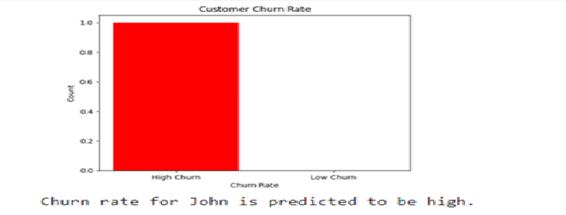
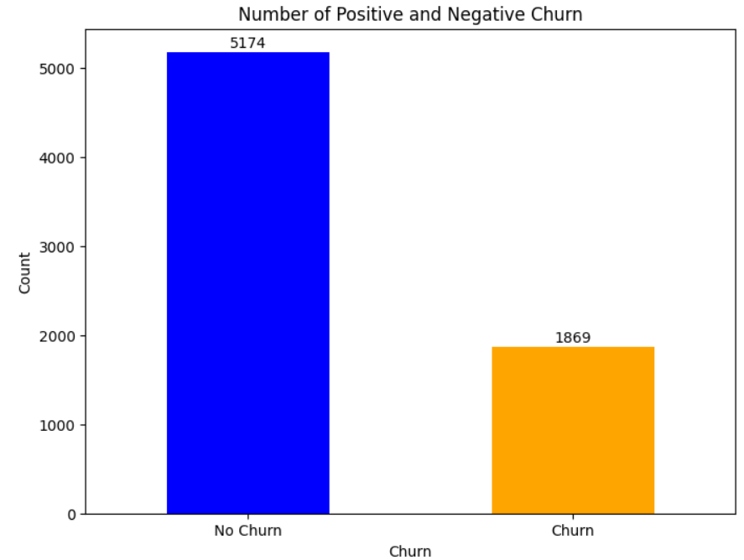
Predicting the churn rate and categorizing it into high or low.
Overall churn prediction of the dataset, No Churn indicating the number of people expected to stay and churn represents the Number Of people to leave.
Churn Rate Prediction of a Customer
Overall Churn

Slide 10
Comparison with Existing Works
 | Description | Data processing | Feature Extraction | Model | Accuracy
My Work | Used the comparison between feature extraction algo for better accuracy | data cleaning, normalization, and handling missing values., | Cuckoo Search, Firefly & Grey wolf Algorithms | Support Vector Machine | 87%
03. C. Zhenhai and Liu. Wei | Used the comparison of two dataset for better accuracy | Data Handling | Not Used | Logistic Regression | 76.52%
04. Dong, T., Shang, W., Zhu, H | classifier based on an improved feature weighting algorithm | data cleaning, normalization, and handling missing values. | feature weighting algorithm | Naïve Bayesian | 80.67%
06. Rodan A, Faris H, Alsakran J, Al-Kadi O | Find best SVM Parameter using Grid Search in cross validation | data normalization, encoding categorical variables, and feature scaling. | Not used | Support Vector Machine | 79.56%

Slide 11
Conclusion And Future Works
Conclusion:Our study has highlighted the effectiveness of nature-inspired algorithms,
Cuckoo Search consistently outperforms Firefly Algorithm (FA) and Grey Wolf Optimizer (GWO) in optimizing Support Vector Machine (SVM) models.
Superior accuracy and precision are demonstrated by Cuckoo Search in churn prediction.
Ensures Cuckoo Search as a highly effective optimization for telecom churn prediction with SVM model.
Future Work:
Our study paves the way for refining feature optimization methods in sentiment analysis.
Integration of advanced algorithms is suggested for improved analysis.
Expansion of analysis to include multi-modal data sources is recommended.

Slide 12

References:
Brându¸soiu, I., Toderean, G., Beleiu, H.: Methods for churn prediction in the pre-paid mobile telecommunications industry. In: 2016 International conference on communications (COMM), pp. 97–100. IEEE (2016)
Y. Xiao, C. He and J. Xiao, "Study on Customer Churn Prediction Methods Based on Multiple Classifiers Combination", 2009 Third International Symposium on Intelligent Information Technology Application, 2009
C. Zhenhai and Liu. Wei, "Logistic Regression Model and Its Application", Journal of Yanbian University(Natural Science Edition), vol. 38, no. 01, pp. 28-32, 2012.
Dong, T., Shang, W., Zhu, H.: Naïve bayesian classifier based on the improved feature weighting algorithm. In: International Conference on Computer Science and Information Engineering, pp. 142– 147. Springer (2011)
Y. Xiao, C. He and J. Xiao, "Study on Customer Churn Prediction Methods Based on Multiple Classifiers Combination", 2009 Third International Symposium on Intelligent Information Technology Application, 2009.
Rodan A, Faris H, Alsakran J, Al-Kadi O (2014) A support vector machine approach for churn prediction in telecom industry. International journal on information 17(8):3961–3970
Ullah, B. Raza, A. K. Malik, M. Imran, S. U. Islam and S. W. Kim, "A Churn Prediction Model Using Random Forest: Analysis of Machine Learning Techniques for Churn Prediction and Factor Identification in Telecom Sector", IEEE Access, vol.

Slide 13


